Slide 1


Climate Modelling
Global Climate Change – Week 7
Dr Thomas Bannan
Thomas.Bannan@Manchester.ac.uk

Slide 2
Discussion
If you were building a climate model, what variables would you absolutely need to include?
If you wanted to test whether a climate model works, how would you do it?

Slide 3

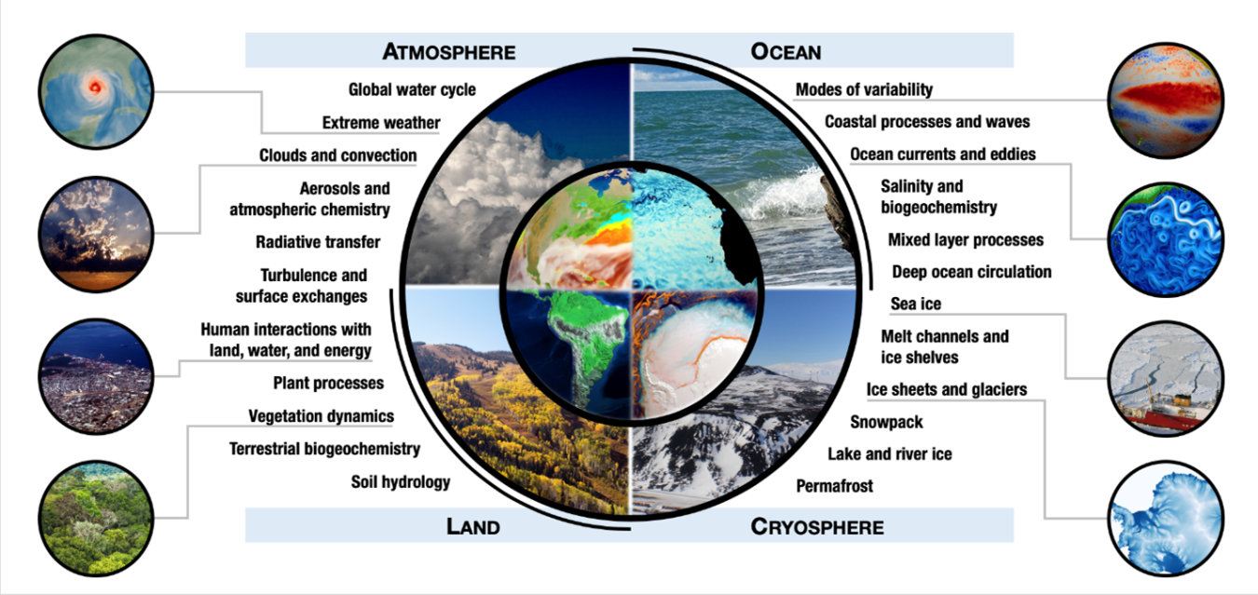
Brief Answer

Slide 4
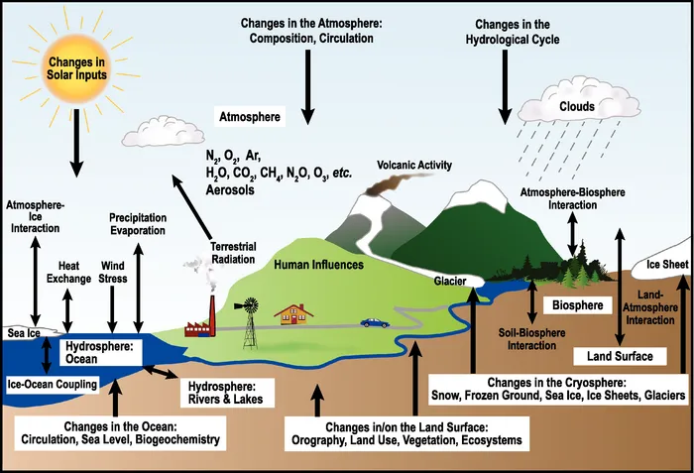
Brief Answer

Slide 5
Brief Answer
How would you test whether a climate model works?
Run the model to simulate past climate conditions rather than the future.
Compare the model output with real observations such as temperature, rainfall, and atmospheric circulation records.
Check whether the model reproduces long-term trends, seasonal cycles, and natural variability.
Test the model with and without specific forcing factors (e.g. greenhouse gases or volcanic aerosols) to see whether it captures observed changes.
Compare results with multiple independent datasets (satellite observations, weather stations, ocean measurements).
Evaluate how well the model reproduces large-scale climate patterns such as El Niño–Southern Oscillation (ENSO)
Test the model across different regions and timescales to assess where it performs well or poorly.
Compare results from multiple climate models to see whether they produce consistent outcomes.
This process is called hindcasting, and good agreement with observations increases confidence that the model can project future climate change.

Slide 6
Global Climate Change
Week 7, Questions and Answers
Dr Thomas Bannan

Slide 7
Q1.
Why do scientists use models to study climate change?

Slide 8
Q1. Answer
Why do scientists use models to study climate change?
Climate models are used because they allow us to develop and understanding of:
Past climate changes by recreating historical conditions (hindcasting)
Forecasting future climate trends under various greenhouse gas emission scenarios.
Examining the impacts of different factors (e.g., GHG, aerosols, deforestation, land use change…….) on global temperature and the effect these may have
These models are based on physics and incorporate real-world data, improving our understanding of how climate will change into the future
Accurate measurements are essential for verifying and improving the reliability of global climate models. They provide the observational data needed to test model predictions, identify uncertainties, and guide future model development.

Slide 9
Q2.
What are the major uncertainties in climate models, and how can they be improved?

Slide 10
Q2. Answer
What are the major uncertainties in climate models, and how can they be improved?
Sources of uncertainty include but are not limited to:
Cloud representation: Clouds contribute to both warming and cooling, but small-scale cloud processes are challenging to model. This is a very active are of research at the University.
Aerosol effects: The cooling impact of aerosols (e.g., from pollution or volcanic eruptions) is not yet fully understood. Again, this is a very active area of research at the University.
Regional climate responses: Model resolution limits accuracy at a local scale, particularly for extreme weather events. This makes identifying local impacts challenging.
Advances can be made through higher-resolution models, enhanced observational data (e.g., satellite measurements or more dense ground-based observations), and maybe the use of artificial intelligence to refine operations.

Slide 11
Q3.
What is the difference between natural variability and human-induced climate change? How do we model their effects in climate studies?

Slide 12
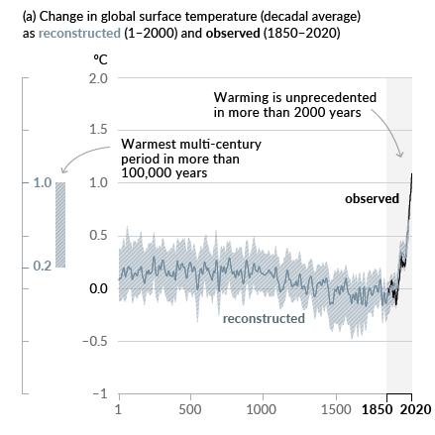
Q3. Answer
What is the difference between natural variability and human induced climate change? How do we model their effects in climate studies?
Natural variability refers to fluctuations in the climate system caused by processes such as ocean circulation, solar activity, solar input and volcanic eruptions.
Human induced climate change, by contrast, results from activities such as burning fossil fuels, deforestation, and industrial emissions, which alter greenhouse gas concentrations.
Observational records, including temperature and precipitation data, are compared with climate models to distinguish natural variability from anthropogenic effects.
Climate models can also be run with and without anthropogenic inputs to differentiate between the two types of processes.

Slide 13
Q4.
What are the key components of a Global Climate Model, and why is coupling different models important?

Slide 14
Q4. Answer
What are the key components of a Global Climate Model, and why is coupling different models important?
GCMs consist of five major components:
Atmosphere – Governs weather patterns, temperature, and precipitation.
Cryosphere – Includes ice sheets, glaciers, and sea ice, which influence albedo and ocean circulation.
Chemistry – Represents atmospheric composition, including greenhouse gases and aerosols.
Ocean – Regulates heat distribution through currents and interacts with the atmosphere.
Biosphere – Encompasses vegetation, land use, and ecosystems, which affect carbon cycling and climate feedbacks.
Coupling these components is crucial, as their interactions drive climate variability. For example:
Ocean currents influence atmospheric circulation patterns.
Land-use changes impact surface albedo and greenhouse gas concentrations.
Ice dynamics regulate sea level and energy balance.
Without coupling, GCMs would fail to represent critical climate feedback mechanisms, such as the El Niño-Southern Oscillation (ENSO) and long-term climate shifts. Integrating these components ensures a more accurate representation of Earth’s climate system. Very big steps forward have been made in this space over the last 20 years.

Slide 15
Q5.
How can volcanic eruptions serve as a "natural experiment" for studying climate response to aerosol forcing?

Slide 16
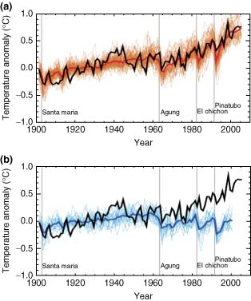
Q5. Answer
How can volcanic eruptions serve as a "natural experiment" for studying climate response to aerosol forcing?
Large volcanic eruptions can inject large quantities of aerosols (mostly sulphate) into the stratosphere, which temporarily cool the Earth's surface.
Aerosols in the stratosphere have a longer lifetime than those in the troposphere, so their cooling effects last longer.
These events allow scientists to observe short-term (around a year) climatic responses to changes in radiative forcing.
Smaller eruptions also emit large concentrations of aerosols in to the troposphere, like anthropogenic sources of aerosol.
They provide real world data to test and validate climate model predictions about aerosol impacts.
Case studies, such as the eruption of Mount Pinatubo in 1991, are important examples where measurable effects have been observed.
Figure to the right shows key examples too

Slide 17
Q6.
Can natural variability explain observed trends in global warming? Why or why not?

Slide 18
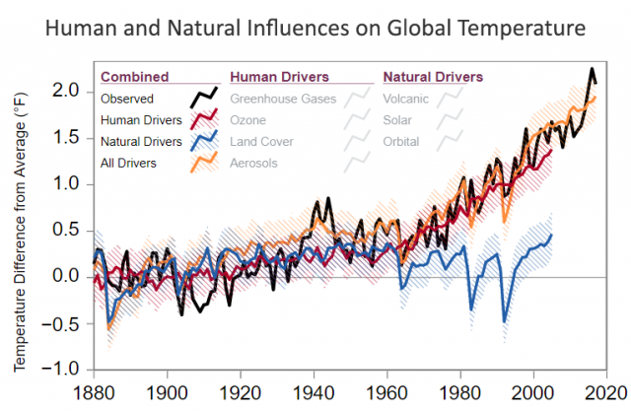
Q6. Answer
Can natural variability explain observed trends in global warming? Why or why not?
Earth’s climate history has been reconstructed using indirect records such as ice cores, tree rings, glacier lengths, pollen remains, and ocean sediments, alongside studies of Earth’s orbital changes.
These records reveal natural climate variability over long timescales, but they do not explain the warming observed since the 1950s. Instead, it is scientifically established that human activities have been the primary driver of this warming.
Key greenhouse gases, carbon dioxide, methane, and nitrous oxide have risen significantly since due to human activities. Can you remember how much by?
Their concentrations are now higher than at any point in the last 800,000 years. These emissions have intensified the greenhouse effect
While natural processes have always influenced climate, they cannot account for the recent warming.
This is all confirmed by the IPCC
Solar variations, for instance, can affect the amount of energy reaching Earth, but satellite data since 1978 show no net increase in solar output, even as global temperatures continue to rise.

Slide 19
Q7.
What do we need to improve future GCMs?

Slide 20
Q7. Answer
What do we need to improve future GCMs?
Climate models are continually evolving with advances in technology and computing power, improving accuracy, resolution, and reducing uncertainties.
Greater availability of observational data, particularly from the oceans, is crucial for refining models, though gaps remain.
Using recent data ensures models reflect current climate conditions for more reliable projections.
Enhanced computing power allows for higher-resolution models, faster computations, and efficient testing of multiple scenarios.
Emerging AI and machine learning techniques further improve model accuracy by identifying patterns in complex processes.
Despite limitations, advanced climate models provide critical insights for mitigating climate change and planning for a sustainable future.

Slide 21
Q8.
How might improvements in observations (e.g., satellites, ocean measurements) help improve climate models?

Slide 22
Q8. Answer
How might improvements in observations (e.g., satellites, ocean measurements) help improve climate models?
Provide more accurate initial conditions for climate model simulations.
Allow scientists to validate model outputs by comparing simulations with real-world measurements.
Improve representation of poorly understood processes such as cloud formation, aerosol effects, and ocean circulation.
Provide better coverage of remote regions (e.g., oceans, polar regions) that previously had limited observations.
Help refine parameterisations used to represent small-scale processes that cannot be directly resolved in models.
Improve estimates of key climate variables such as temperature, precipitation, sea ice extent, and ocean heat content.
Enable continuous long-term datasets, which help detect trends and improve confidence in model projections
And more perhaps…

Slide 23
Q9.
Do you think AI and machine learning will eventually replace physics-based climate models, or just complement them? Why?

Slide 24
Q9. Answer
Do you think AI and machine learning will eventually replace physics-based climate models, or just complement them? Why?
Current GCMs are grounded in physical laws, which ensures that simulations remain physically realistic. AI models typically learn patterns from data and do not inherently enforce these physical constraints.
AI and machine learning are powerful for analysing large datasets. They can rapidly identify patterns in climate observations and model outputs that may be difficult for traditional methods to detect.
Machine learning can improve parameterisations of small-scale processes (such as clouds, turbulence, or convection) that are difficult to represent accurately in traditional models.
AI can significantly accelerate climate simulations. They can reproduce parts of climate models much faster, allowing scientists to run many more scenarios or sensitivity tests.
AI can help improve prediction of extreme events (e.g., heatwaves, storms, or heavy rainfall) by learning from large historical datasets and high-resolution simulations.
However, AI models depend strongly on the quality and quantity of training data, which may limit their reliability when projecting conditions that have not previously occurred.
The most likely future approach is hybrid modelling, where machine learning techniques complement physics-based models to improve accuracy, efficiency, and representation of complex processes.

